Slide 1
01 | Data Analytic Thinking
Cynthia Rudin | MIT Sloan School of Management
Stephen F Elston | Principle Consultant, Quantia Analytics, LLC

Slide 2
Data Analytic Thinking
Data Analytic Thinking: Make decisions based on analysis of data.
Replace intuition with data driven analytical decisions
Extract value from data assets
Increase pace of actions

Slide 3
Data Analytic Example
Medical treatment:
Formerly waited for patient to show symptoms
Classify patients with high risk; take preventative action
Similar to predictive maintenance applications

Slide 4
Data Analytic Example
Detect risking payment accounts:
Formally performed manual retrospective analysis
Real-time decision on account
Classification widely used for anomaly detection

Slide 5
Data Analytic Example
Bicycle Rental Demand:
Under stocking or over-stocking costly
Manual forecasting difficult
Forecast demand to optimize inventory
Forecasting widely used

Slide 6
Data Analytic Thinking
Data Analytic Thinking:
Replace intuition with data driven analytical decisions
Transform raw data to valuable asset
Increase pace of action

Slide 7
01 | Overview of The Data Science Process
Cynthia Rudin | MIT Sloan School of Management

Slide 8
Module Overview
Historical Notes on KDD, CRISP-DM, Big Data and Data Science and their relationship to Data Mining and Machine Learning
Example of the knowledge discovery process

Slide 9
Historical Notes on KDD, CRISP-DM, Big Data and Data Science and their relationship to Data Mining and Machine Learning

Slide 10
Historical Notes
Term “Big Data” coined by astronomers Cox and Ellsworth in 1997
CCC Big Data Pipeline from 2012*
Acquisition / Recording
Extraction /
Cleaning
/ Annotation
Integration
/
Aggregation
/ Representation
Analysis
/
Modeling
Interpretation
Heterogeneity
Scale
Timeliness
Privacy
Human Collaboration
Overall System
*From the Computing Community Consortium Big Data Whitepaper: http://www.cra.org/ccc/files/docs/init/bigdatawhitepaper.pdf
Notes:
Let’s start with historical notes. *Read* So it’s actually kind of an old term that got a bit hyped up a few years ago after the CCC whitepapers on Big Data came out. I’m showing you the CCC big data pipeline from the whitepaper in 2012. It’s nice, it’s an effort to formalize the scientific process that goes into discovering knowledge from data. It’s not just data mining, there’s a lot more to it. In fact, data mining is the 4th step out of 5. Major steps in analysis of big data are shown in the flow at the top. Below it are big data needs that make these tasks challenging. Let me go through the 5 steps.
First you have to go through a process of actually obtaining the data. Perhaps that involves recording how users behave on different websites, so you have to write a script to collect the data properly.
The second step is extraction/cleaning/annotation, where you try to reduce the noise a bit and get rid of the data you don’t directly need. Or if you’re working with free text that’s easy to annotate, you might be able to turn it into a structured table. Basically at this step, you’re turning the data from what is potentially a pile of rubbish into something you might actually be able to work with.
At the third step you are going to set up the data in a way that is directly conducive to data mining. All the text documents are linke properly to the other structured tables, and you have one central database where the information is stored neatly.
:
Ok so that’s the big data pipeline. Now I’m going to show you another, separate big data pipeline, constructed by a separate group of people, at another time. So this is a second group of people trying to formalize the discovery of knowledge from data. Ready?

Slide 11
Historical Notes
KDD (Knowledge Discovery in Databases) Process
Interpretation / Evaluation
Data Mining
Transformation
Preprocessing
Information
Patterns
Selection
Transformed Data
Preprocessed Data
Target Data
Data
Based on content in “From Data Mining to Knowledge Discovery”, AI Magazine, Vol 17, No. 3 (1996)
http://www.aaai.org/ojs/index.php/aimagazine/article/view/1230
Notes:
Way before the CCC had “big data” as a twinkling in their eyes. And the CCC people did not cite the original KDD paper – they didn’t know about each other. Perhaps there is something fundmental here about this process. Maybe it’s like an important number, like pi or the golden ratio or something. This sort of universal process that people separately discover. Anyway, so this is the kdd process.

Slide 12
Historical Notes
KDD (Knowledge Discovery in Databases) Process
Interpretation / Evaluation
Data Mining
Transformation
Preprocessing
Information
Patterns
Selection
Transformed Data
*CCC had no citations to KDD
Preprocessed Data
Target Data
1996
Data
Based on content in “From Data Mining to Knowledge Discovery”, AI Magazine, Vol 17, No. 3 (1996)
http://www.aaai.org/ojs/index.php/aimagazine/article/view/1230
Notes:
selection, preprocessing, transformation.
Does it look familiar? It should, because it’s the same as on the previous slide! Same exact steps. So you’re probably not surprised, so what, two groups came up with the same diagram. But look. This diagram is from 1996.

Slide 13
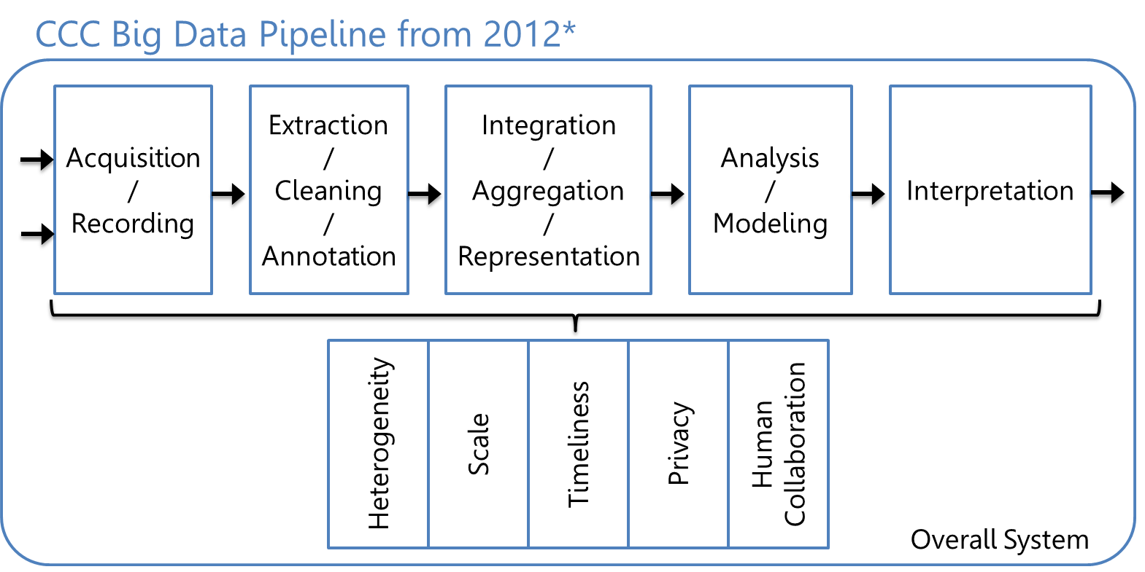
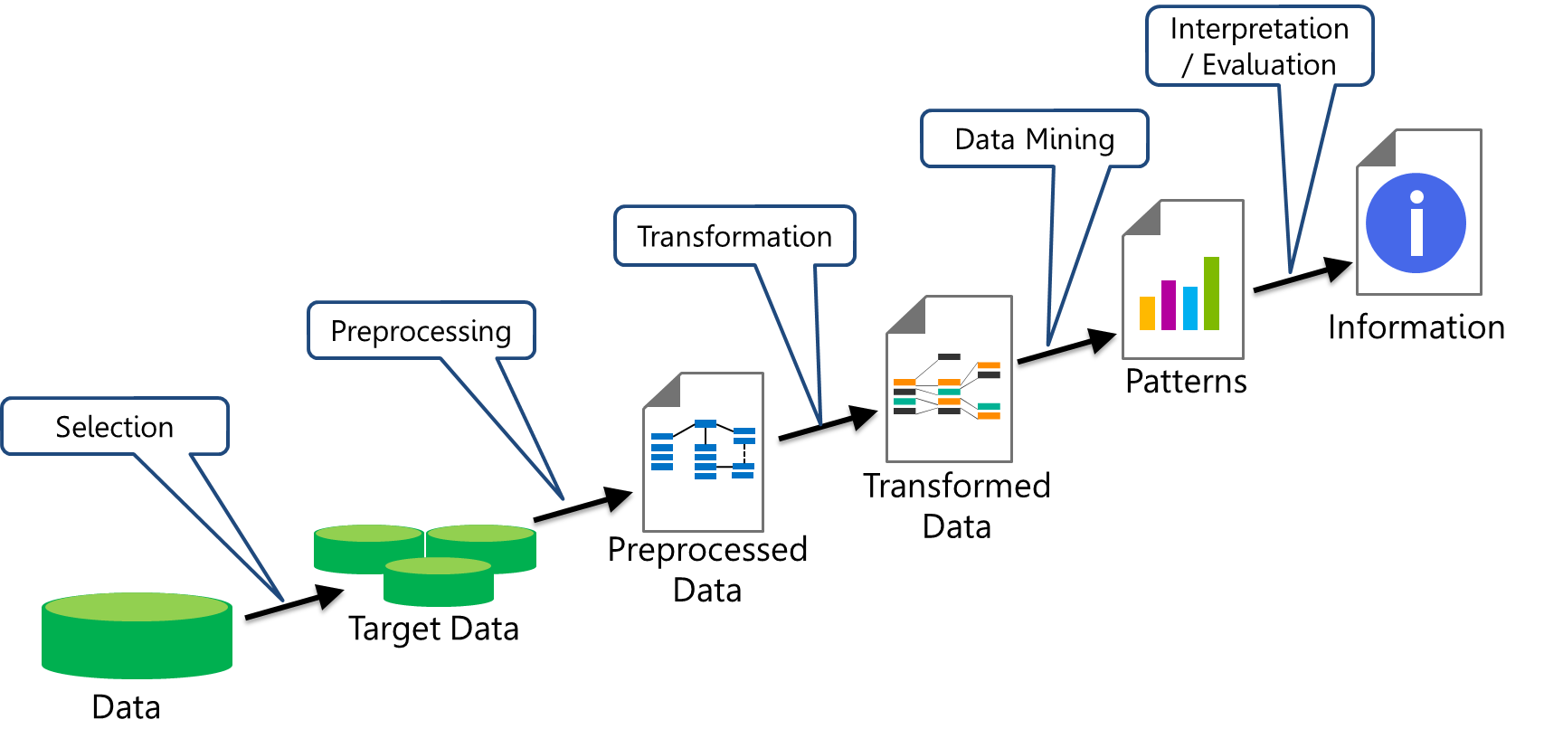
CCC 2012
KDD 1996
Notes:
It seems so abstract but there may be something fundamental about this.
BTW reading both of these articles is really inspiring. One thing I want to point out again is that data mining is a part of the process.

Slide 14
Historical Notes
KDD (Knowledge Discovery in Databases) Process
Interpretation / Evaluation
Data Mining
Transformation
Preprocessing
Information
Patterns
Selection
Transformed Data
Preprocessed Data
Target Data
Data
Based on content in “From Data Mining to Knowledge Discovery”, AI Magazine, Vol 17, No. 3 (1996)
http://www.aaai.org/ojs/index.php/aimagazine/article/view/1230
Notes:
One part, not all of it. Granted, it’s like the climax of a story, but like any story, the set up of the story really makes the whole thing work. *pause*

Slide 15
Historical Notes
CRoss Industry Standard Process for Data Mining (CRISP-DM)
Business Understanding
Data Understanding
Data Preparation
Modeling
Evaluation
Deployment
Identify project objectives
Collect and review data
Select and cleanse data
Manipulate data and draw conclusions
Evaluate model and conclusions
Apply conclusions to business
From 2000, 77 pages
Notes:
Now, KDD wasn’t the only game in town before the CCC whitepapers. This is CRISP-DM – Cross.... These guys were really serious about formalizing the process. They wrote a 77 page manual on how to do this stuff. I actually like CRISP-DMs process the best, because it includes business understanding and data understanding. I also love all the backwards arrows showing how many iterations you do within this process on a regular basis. Anyway, this is the process I tend to think of.

Slide 16
Historical Notes
The stages are basically the same no matter who invents or reinvents the (knowledge discovery / data mining / big data / data science) process. You may not always need all the stages.
Data science is an iterative process.
Backwards arrows on most process diagrams.
Notes:
Just to summarize

Slide 17
Example of the Knowledge Discovery Process

Slide 18
Knowledge Discovery Process Example
I’ll walk you through the knowledge discovery process with an example – the process of predicting power failures in Manhattan.
Notes:
Just to summarize

Slide 19

Motivation for Example
In NYC the peak demand for electricity is rising.
The infrastructure dates back to the 1880’s from the time of Thomas Edison.
Power failures occur fairly often (enough to do statistics) and are expensive to repair
We want to determine how to prioritize manhole inspections in order to reduce the number of manhole events (fires, explosions, outages) in the future.
This is a real problem.

Slide 20
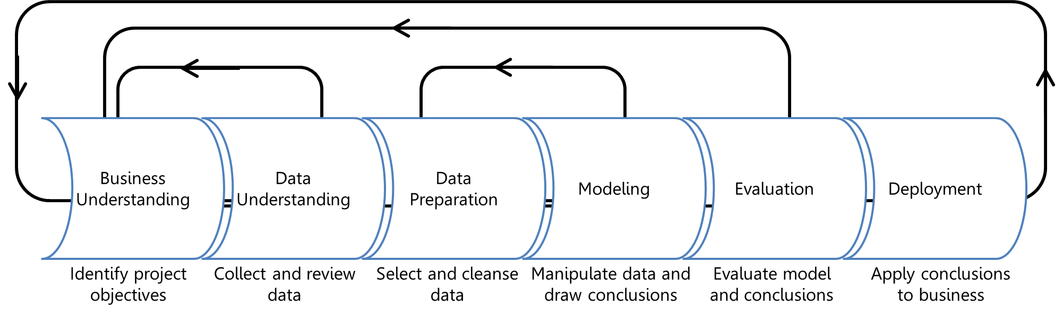
Stages in the knowledge discovery process
Opportunity Assessment & Business Understanding
Data Understanding & Data Acquisition
Data Preparation, including Cleaning and Transformation
Model Building
Policy Construction
Evaluation, Residuals and Metrics
Model Deployment, Monitoring, Model Updates
Notes:
See CRISP-DM for the 77 page description

Slide 21
Opportunity Assessment & Business Understanding
What do you really want to accomplish and what are the constraints? What are the risks? How will you evaluate the quality of the results?
For manhole events the general goal was to “predict manhole fires and explosions before they occur.” We made it more precise:
Goal 1: Assess predictive accuracy for predicting manhole events in the year before they happen.
Goal 2: Create a cost-benefit analysis for inspection policies that takes into account the cost of inspections and manhole fires. Determine how often manholes need to be inspected.
Notes:
*read* These goals are concrete – we can form concrete assessments of how well we did with these tasks.

Slide 22
Data Understanding & Data Acquisition
Data were:
Trouble tickets – free text documents typed by dispatchers documenting problems on the electrical grid.
Records of information about manholes
Records of information about underground cables
Electrical shock information tables
Extra information about serious events
Inspection reports
Vented cover data
V’s of Big Data include “Variety” and “Veracity”
How do you know what data to trust?
Notes:
Cables were not matched to manholes

Slide 23
Data Cleaning and Transformation
Sometimes 99% of the work

Slide 24
Data Cleaning and Transformation
Turn free text into structured information:
Trouble tickets turned into a vector like:
Serious / Less Serious / Not an Event
Year
Month
Day
Manholes involved
…
Try to integrate tables (create unique identifiers):
If you join manholes to cables, half of the cable records disappear
Notes:
Before this step you might have a giant pile of garbage.

Slide 25
Knowledge Discovery Process
Notes:
I like to think of the knowledge discovery process sort of like alchemy. Alchemy is where you try to turn lead into gold. Except that alchemy doesn’t work, but data often does!
Business understanding is like – am I really going to get gold out of this? What constitutes gold here
Data understanding is like – what are my raw materials that I’m going to collect
Data prep is an important step – that’s where you purify all the raw ingredients and get rid of all the junk and contaminants.
Modeling is where you actually do the transformation of the raw ingredients into gold – that’s why people are obsessed with it, and why other people think it’s magic, but really, as long as you did the processing right, this step is generally pretty easy. And it does work like magic. But you’ll see it’s definitely not magic!
Evaluation is where the appraiser comes and tells you how much the gold is worth, and of course deployment is where the whole village comes to buy your gold. Back to the modeling step.

Slide 26
Model Building
Often predictive modeling, meaning machine learning or statistical modeling
If you want to answer a yes/no question, this is classification.
For manholes, will the manhole explode next year? Y/N
If you want to predict a numerical value, this is regression.
If you want to group observations into similar-looking groups, this is clustering.
If you want to recommend someone an item (e.g., book/movie/product) based on ratings data from customers, this is a recommender system.
Note: There are many other machine learning problems.
Notes:
Predictive doesn’t necessarily mean in the future time-wise. It could mean prediction of a new circumstance you haven’t seen before.

Slide 27
Policy Construction
How will your model be used to change policy?
For manholes, how should we recommend changing the inspection policy based on our model?
Consider using social media and customer purchase data to determine customer participation if Starbucks moves into New City. After the model is created, how to optimize where the shops are located, how big they are, and where the warehouses are located.
Model building is predictive, Policy Construction is prescriptive.

Slide 28
Evaluation
How do you measure the quality of the result? Evaluation can be difficult if the data do not provide ground truth.
For manhole events, we had engineers at Con Edison withhold high quality recent data and conduct a blind test.
Notes:
That’s how they knew they could trust us.

Slide 29
Deployment
Getting a working proof of concept deployed stops 95% percent of projects.
Don’t bother doing the project in the first place if no one plans to deploy it.*
Keep a realistic timeline in mind. Then add several months.
While the model is deployed it will need to be updated and improved.
* Unless it’s fun.
Notes:
It’s like “Hey I turned lead into gold” and the reaction is “well, that’s nice”
Goals might change, data itself might change, data might change as a reaction to the new policy, you observe something that you didn’t expect and need to put it in, etc.

Slide 30
Knowledge Discovery is an Iterative Process
Notes:
*ad lib about iterative process*
At least if you have this outline, it sort of helps you figure out what to charge people for your services. It’s not like you can just charge them for doing some modeling, you actually have to charge them for all parts of this knowledge discovery process and for the iterations you’re going to do to fix up the system. A proposal to work might actually include each of these steps in the process.

Slide 31
Summary
Several attempts to make the process of discovering knowledge scientific
KDD, CRISP-DM,CCC Big Data Pipeline
All have very similar steps
Data Mining is only one of those steps (but an important one)

Slide 32
Introduction to Data Science Technologies
Stephen F Elston| Principle Consultant, Quantia Analytics, LLC

Slide 33
Outline
Overview of data science technology
Tour of Azure ML Studio
Azure ML Experiments
Azure tables and data types
R and Python for Azure ML
SQL for Azure ML
Machine learning example

Slide 34
Tools for Data Science
Open source tools: R and Python
Azure Machine Learning
Easy to use
Easy to deploy
Data science stacks

Slide 35
Why Open-Source Tools?
R and Python widely used in data science
Highly interactive
Good visualization
Vast packages (libraries) of utilities and algorithms
Excellent development environments
Jupyter notebooks

Slide 36
R or Python?
R and Python are widely used in data science
Powerful open-source data science tools
Both have advantages and disadvantages
Python tends to be more systematic and faster
R contains wider range of packages and capabilities
R offers grammar of graphics

Slide 37

Cortana Intelligence Suite
Information Management
Big Data Stores
Machine Learning and Analytics
Intelligence
People
Data Sources
Data Factory
Data Lake Store
Machine Learning
Cognitive Services
Data Catalog
SQL Data
Warehouse
Data Lake Analytics
Bot Framework
Web
Apps
HDInsight
(Hadoop and Spark)
Mobile
Event Hubs
Cortana
Apps
Bots
Sensors and devices
Dashboards & Visualizations
Stream Analytics
Automated Systems
Power BI
Data
Data
Intelligence
Action
Notes:
T: Cortana Intelligence provides everything you need to transform your organization’s data into intelligent action. Next, let’s take a look at another demo.

Slide 38
Tour of Azure ML

Slide 39
Why Azure ML?
Easy to use
Quickly deploy production solutions as web services
Models run in a highly scalable cloud environment
Secure cloud environment for data and code
Powerful, efficient built-in algorithms
Extensible with, SQL, Python, and R
Integration with Jupyter notebooks

Slide 40
Azure ML Free Tier Account
Free Tier Account
Unlimited time, with restricted priority
Paid account provides full performance

Slide 41
Azure ML Studio
Experiments contain workflow
Experiments constructed of modules
Experiments in sharable workspace
Modules transform data, compute models, score models, and evaluate models
Create custom modules with SQL, R and Python
Deploy solutions as web services

Slide 42
Data Passed from Module to Module in Azure ML Tables
Module
Rectangular table
N Columns
M Rows
Equal length columns
Col1, Col2, Col3, ………………………,ColN
Val11, Val12, Val13, ……………………,Val1N
………., ……….., ………., ……………………., ………
ValM1, ValM2, ValM3, ………………, ValMN
Module

Slide 43
Azure ML Table Data Types
Numeric; Floating Point
Numeric: Integer
Boolean
String
Categorical
Date-time
Time-Span
Image

Slide 44
Uploading data into Azure ML

Slide 45
Developing and testing R and Python
Azure ML is a production environment
Interactively develop and test in IDE
Subset data as needed – download as .csv
IDE has powerful editor and debugger
Cut and paste code into Execute R/Python Script module to test in Azure ML
Jupyter notebooks

Slide 46
Execute R Script
Azure ML Tables
zip file
myFrame <- maml.mapInputPort(1,2)
source("src/myScript.R")
maml.mapOutputPort(“myFrame")
print(“Hello world")
Azure ML Table
R Device Port

Slide 47
Execute Python Script
Azure ML Tables
zip file
def azureml_main(inFrame1, inFrame2)
import my_package
return myFrame
print(“Hello world")
Azure ML Table
Python Device Port

Slide 48
Debugging R and Python in Azure ML
Code tested in IDE should run in Azure ML, but…….
If error occurs look at the error.log or output.log
From R use print() function
From Python use sys.stderr.write() from sys

Slide 49
SQL in Azure ML
SQL data I/O; Reader and Writer modules
SQL transformation module
SQL resources
Querying with Transact-SQL, Graeme Malcom and Geoff Allix, https://www.edx.org/course/querying-transact-sql-microsoft-dat201x-0

Slide 50
Simple Machine Learning Example

Slide 51
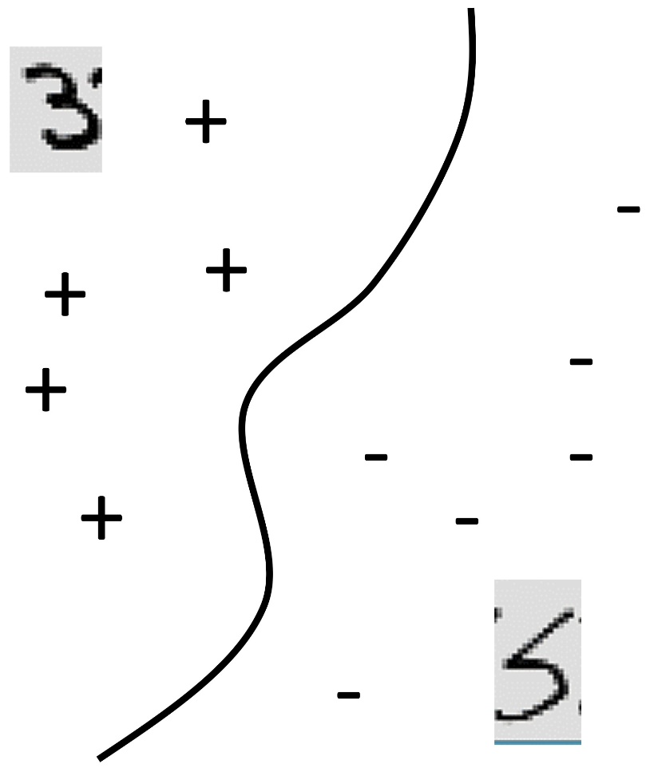
Classification
Formally, given training set (x_{i,}y_{i}) for i=1…n, we want to create a classification model f that can predict label y for a new feature values x.
f(x)>0
L1
f(x)=0
f(x)<0
f(x) = function(features)
Feature 2
L2
0
Feature 1

Slide 52
Machine learning workflow
Input data
Data Transformation
Define Model
Split Data
Train Model
Score (prediction)
Evaluate Model

